Slide 1
COIL VIRTUAL EXCHANGE FOR GENERAL EDUCATION
CINDY XINQUAN JIANG
OFFICE OF INTERNATIONAL AFFAIRS

Slide 2
COIL Virtual Exchange Initiatives
COIL – Collaborative Online International Learning
Launched in 2020
COIL Learning Community (SP2020, SP2021, AU2023)
30+ instructors (main & regional campus) and international parnters
Count as GE Integrative Practices – Global and intercultural learning

Slide 3
COIL Virtual Exchange Today
COIL Learning Community
$2,000 grant, with DITL, international faculty from Brazil and Colombia
Resources for partnering, course design and GE course support
Community of Practice
Forum for COIL faculty and practitioners
COIL Coordinator and fellow (.25 FTE)

Slide 4
How does COIL Virtual Exchange work?
2+ teachers
2+ cohorts of students
2+ institutions
2+ cultures
Shared learning outcomes
Collaborative project
Co-facilitation
Cross-cultural communication and intercultural learning
Lasts 5-8 weeks
Project based or course based

Slide 5
COIL COMPONENTS
INTERCULTURAL LEARNING ACTIVITY
(ICEBREAKER)
COLLABORATION PROJECT
STRUCTURED REFLECTION
Structured intercultural conversations
Facilitated reflection
Targeted intercultural learning outcomes
Working in diverse teams
Collaborative learning
Practice intercultural communication and problem-solving skills
Individual and/or group reflections
Reflection on cross-cultural collaboration as well as project outcomes
Targeted intercultural development

Slide 6
FRIT 3054: Intercultural competence for global citizenship
COIL Timeline
ASSESSEMENT
WEEK 1 - 3
WEEK 4-7
WEEK 8
ASSESSEMENT
✓
✓
IDI
ICEBREAKER
REFLECTION
COLLABORATIVE TEAMWORK
REFLECTION
TEAMWORK
REFLECTION
IDI
Take the IDI
Introduction
Name story
Hobbies
Cultural symbols
Team interview rationale
Interview plan
Team interview
Project video
Retake the IDI

Slide 7
What is the difference between COIL and study abroad?
COIL & Study abroad

Slide 8
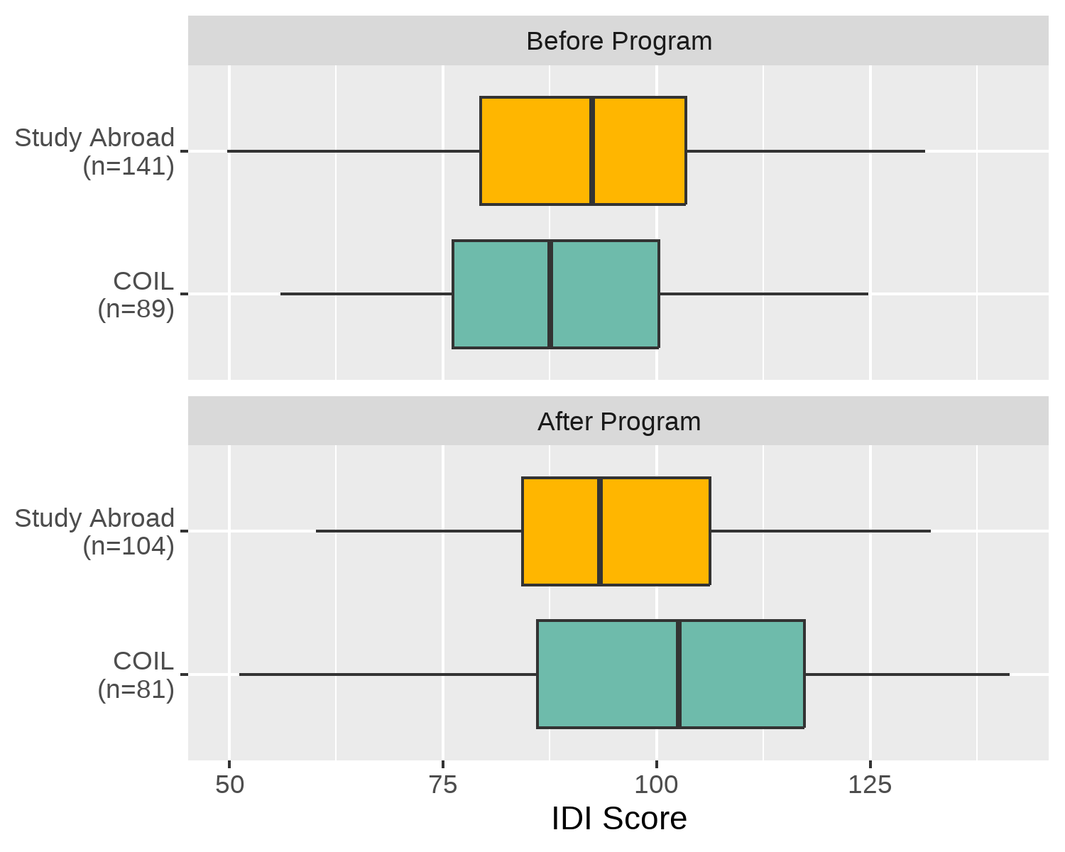
IDI pre and post-test for SA and COIL participants
Pre-test: Average mean IDI score for SA participants is 3.98 points higher than COIL.
Post-test: COIL students’ average score is 6.39 points higher than SA students (p = 0.02).

Slide 9
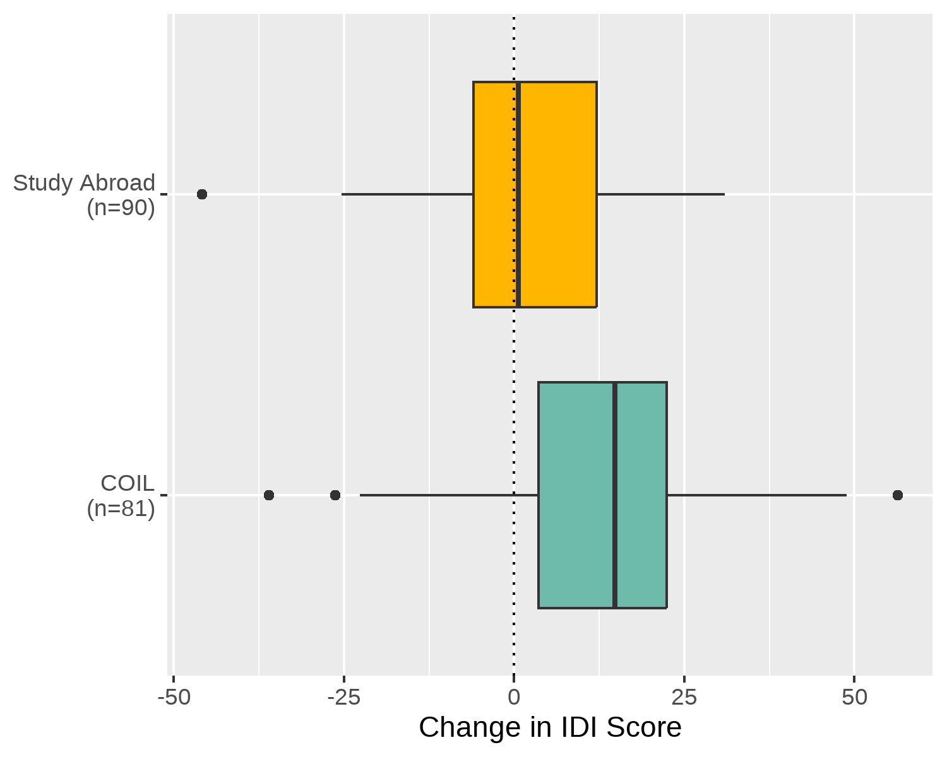
Individual gains in IDI
Average gain for SA = 2.16 points
Average gain for COIL = 13.33 points (p <.001)

Slide 10
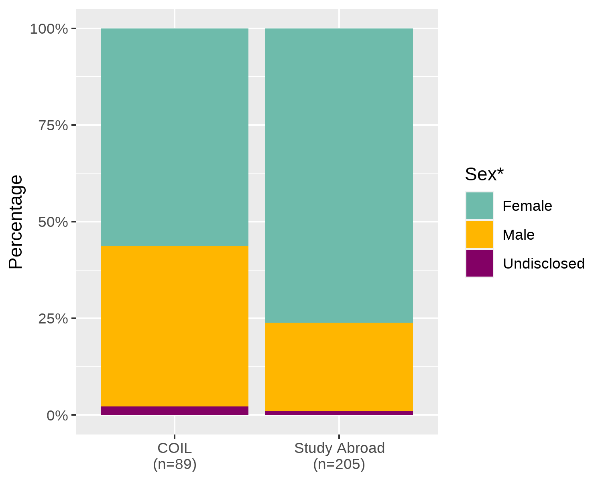
Student Demographics: Sex
*As recorded in the university’s Student Information System

Slide 11
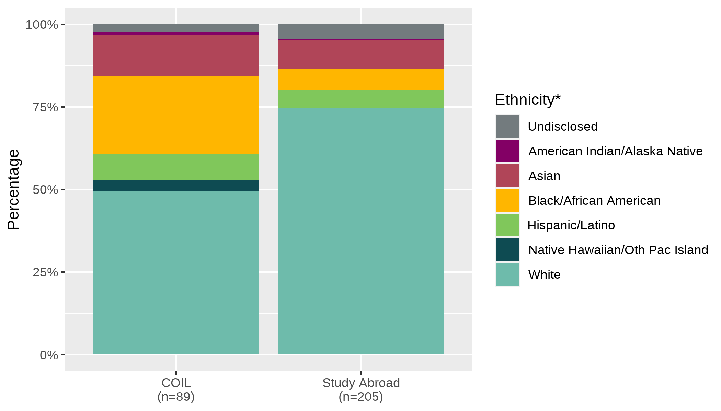
Student Demographics: Race and Ethnicity
*As recorded in the university’s Student Information System

Slide 12
THANK YOU
CINDY JIANG (JIANG.533@OSU.EDU)

